Slide 1

DAYANANDA SAGAR UNIVERSITY
SCHOOL OF ENGINEERING
Department of Computer Science and Technology
Major Project Phase-II
“DETECTION OF THYROID DISORDER USING MACHINE LEARNING APPROACH”
Under the Supervision,
Prof. Meghana G
Presented By:
R Siresha (ENG19CS0241)
R Ajith Kumar (ENG19CS0254)
Ritika G M (ENG19CS0257)
Sathvika Patil (ENG19CS0287)
TEAM NO : 59

Slide 2
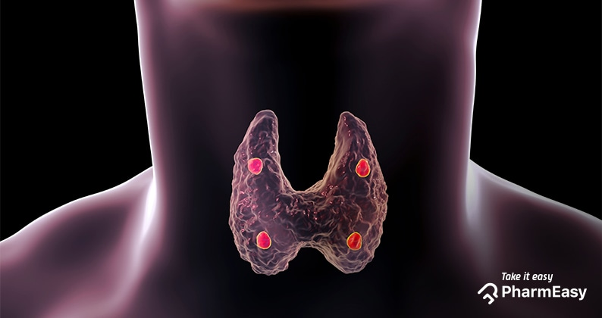

Slide 3
OVERVIEW
ABSTRACT
PROBLEM STATEMENT
INTRODUCTION
STATE OF THE ART WORK
DESIGN
METHODOLOGY
OUTPUT SCREENSHOTS
REFERENCES
Dept of CSE., SOE-Dayananda Sagar University

Slide 4
ABSTRACT
The disease like Thyroid is found in 42 million people in India. The secretions of thyroid hormones are culpable in controlling the metabolism.
This project presents several methods for thyroid disease diagnosis related to the machine learning algorithms.
The machine learning plays a decisive role in the process of disease prediction and this paper handles the analysis and classification models that are being used in the thyroid detection.
We use multiple machine learning algorithms such as Naïve Bayes, SVM and Random Forest to detect the thyroid disorders based on the performance ie., the highest accuracy.
Dept of CSE., SOE-Dayananda Sagar University

Slide 5
PROBLEM STATEMENT
The symptoms of thyroid disease often vary from person to person and are non-specific, so a proper diagnosis can easily be misdiagnosed.
Finding an accurate solution to this problem for healthcare practitioners via machine learning algorithms for diagnosing a particular thyroid disease that a person may have will cause an immense decrease in misdiagnoses as it is capable of distinguishing between problems of the thyroid gland.
Dept of CSE., SOE-Dayananda Sagar University

Slide 6
INTRODUCTION
Thyroid illnesses and disorders are widespread hormonal problems that affect the majority of the world’s population.
Hyper-and hypothyroidism may be caused by thyroid gland dysfunction, secondary to pituitary gland failure, or tertiary to hypothalamic malfunction.
Due to dietary iodine deficiency, goiter or active thyroid nodules may become prevalent in some regions, with a prevalence of up to 15%.
The thyroid gland can also be the location of different kinds of tumors and can be a dangerous place where endogenous antibodies wreak havoc (autoantibodies).
Machine learning algorithms are one of the best solutions to many problems that are difficult to solve, one such is thyroid detection.
Classification is a data extraction technique (machine learning) used to predict and identify many diseases, such as thyroid disease, which we researched and classified here because machine learning algorithms play a significant role in detecting thyroid disease and because these algorithms are high performing and efficient and aid in detecting thyroid.
Dept of CSE., SOE-Dayananda Sagar University

Slide 7
STATE OF THE ART-WORK
Author’s Name/ Paper Title | Conference/Journal Name and year | Technology/ Design | Results shared by author
‘Thyroid Disease Treatment prediction with machine learning approaches’ Lerina Aversanoa, Mario Luca Bernardia, Marta Cimitileb, Martina Iammarino | Elsevier 25th International conference Year - 2021 | Treatment – LT4 Machine learning algorithms ABC, GBC, XGBC, CBC, DCC (EXTC, RFC) | Discretization and balancing as data pre-processing and Extra-Trees Classifier as a machine learning model with highest accuracy 84%
‘A study on thyroid disease using datamining algorithm’ Dr. G. Rasitha Banu, M.Baviya, Dr.Murtaza | International Journal of Technical Research and Applications Year - 2015 | Two main methods – J48 technique and decision stump tree. | The J48 algorithm has 99.5% accuracy higher than decision stump tree algorithm.
Dept of CSE., SOE-Dayananda Sagar University

Slide 8
Author’s Name/ Paper Title | Conference/Journal Name and year | Technology/ Design | Results shared by author
‘Hypothyroidism Prediction and Detection Using Machine Learning’ Hebatullah Mohammad Almahshi, Esraa Abdallah Almasri, Hiam Alquran, Wan Azani Mustafa, Ahmed Alkhayyat | 5th International Conference on Engineering Technology and its Applications 2022- (5thIICETA2022) | Classifiers used in this paper are support vector machine (SVM), Naive Bayes and decision trees. | The decision tree algorithm shows highest accuracy with 95.6%
‘Thyroid Disease Detection using Soft Computing Techniques’ Marissa Lourdes De Ataide and Amita Dessai | International Research Journal of Engineering and Technology (IRJET) | Thyroid dataset is collected from UCI repository. Multilayer perceptron Classifier is used for training and classification. | Classification of thyroid disease into euthyroid , hyperthyroid and hypothyroid gave an accuracy of 97.5% and further Classification of hypothyroid into primary, secondary and tertiary hypothyroid gave accuracy of 91.7%.
Dept of CSE., SOE-Dayananda Sagar University

Slide 9
Author’s Name/ Paper Title | Conference/Journal Name and year | Technology/ Design | Results shared by author
‘Application of machine learning algorithms to predict the thyroid disease risk: an experimental comparative study’ Saima Sharleen Islam, Md. Samiul Haque, M. Saef Ullah Miah, Talha Bin Sarwar and Ramdhan Nugraha | PeerJ Computer Science Year - 2022 | machine learning algorithms: ANN, KNN, Random Forest, Decision Tree | Among all, the ANN classifier outperforms others with an accuracy of 95.87%.
‘Prediction of thyroid disorders using advanced machine learning techniques’ Priyanka Duggal, Shipra Shukla | IEEE year - 2020 | Machine learning algorithms used are SVM, Random Forest and Naïve Bayes | The highest accuracy is for SVM equal to 92.92%
Dept of CSE., SOE-Dayananda Sagar University

Slide 10
Author’s Name/ Paper Title | Conference/Journal Name and year | Technology/ Design | Results shared by author
‘Thyriod detection using machine learning’ Chandan R, Chethan vasan, Chethan MS, Devikarani Hs | International journal of engineering applied sciences and technology Year - 2021 | Classifiers used in this paper are support vector machine(SVM), decision tree, logistic regression, K-nearest neighbors, | The highest accuracy is for logistic regression algorithm with 90.2%
‘Empirical method for thyroid disease classification using a machine learning approach’ Muhammad hamid,Tahir alyas,Khalid Alissa | Journal of biomedicine and biotechnology, Hindawi Year - 2022 | Classifiers used are decision tree, random forest algorithm, KNN | The highest accuracy is for random forest algorithm equal to 94.8% accuracy and 91% specificity
NOTE: We visited Dayananda Sagar Hospital for collecting real time data of thyroid
Dept of CSE., SOE-Dayananda Sagar University

Slide 11
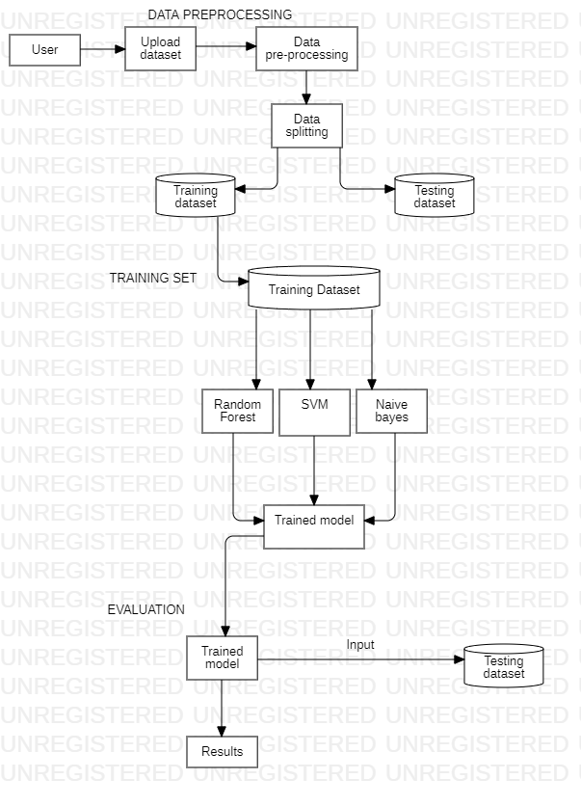
DESIGN
FLOW CHART DIAGRAM
Dept of CSE., SOE-Dayananda Sagar University

Slide 12
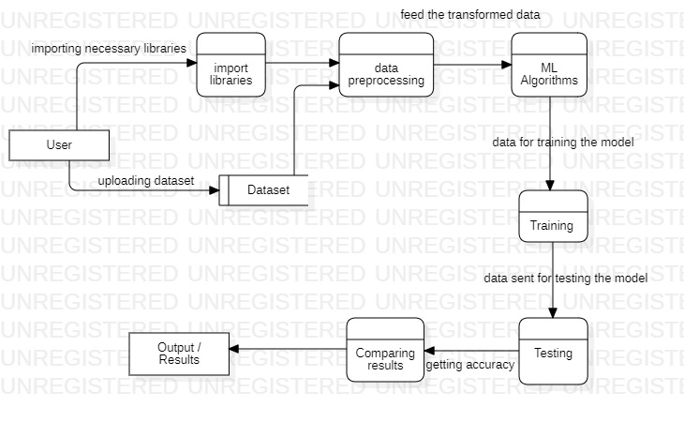
DATA FLOW DIAGRAM
Dept of CSE., SOE-Dayananda Sagar University

Slide 13
METHODOLOGY
Data collection is the first most stage of this project.
Data pre-processing is done to transform the raw data into clean data.
Splitting of data into train and test datasets.
The training dataset is used to fit the model ie., algorithms.
The test dataset is used to assess the models performance.
Finally, the processed data is utilised to implement all the machine learning algorithms such as Random forest, SVM and Naïve Bayes to detect thyroid and to give the best accuracy.

Slide 14
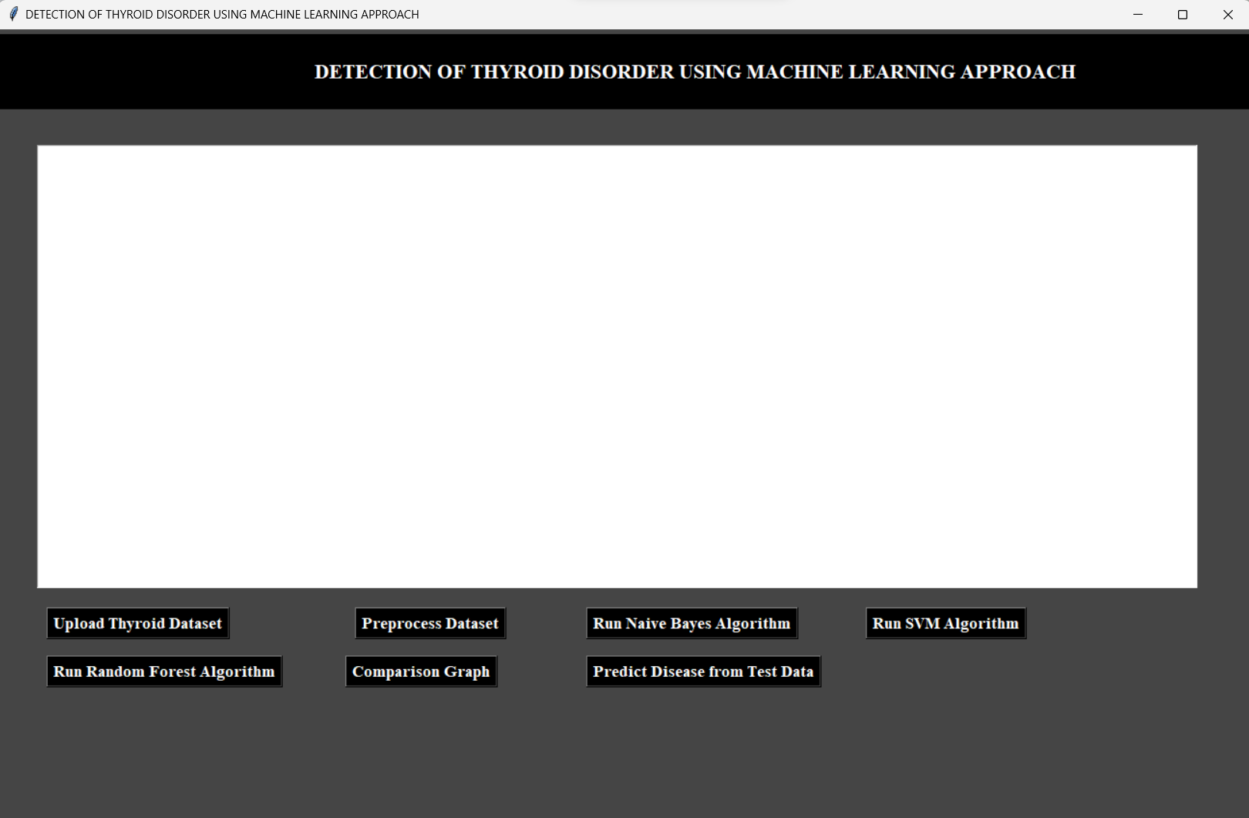
OUTPUT SCREENSHOTS

Slide 15
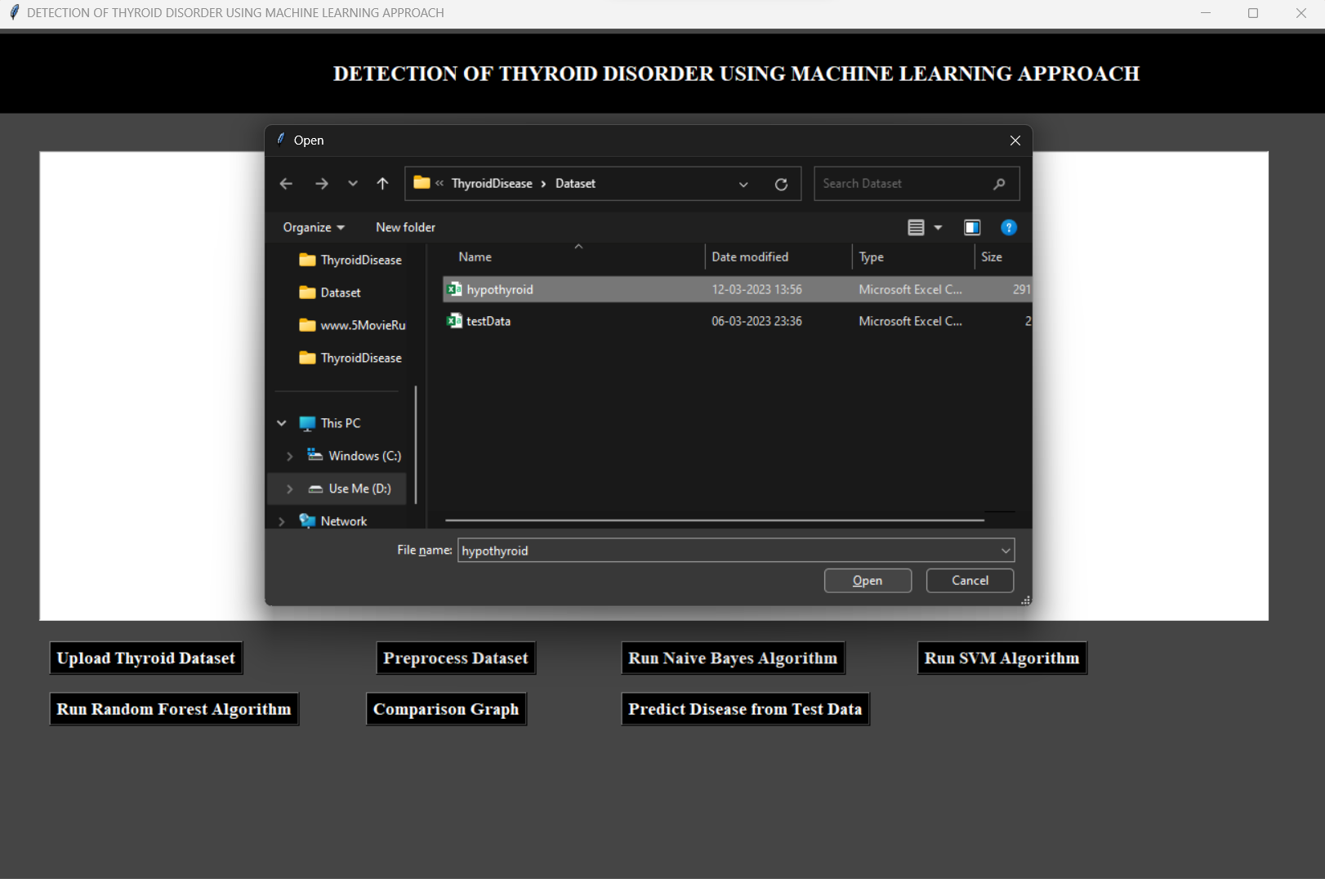

Slide 16
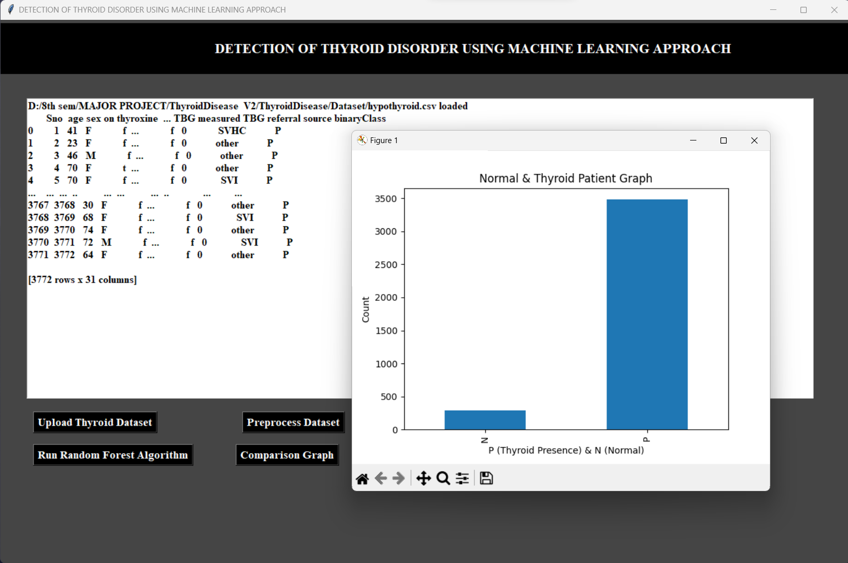

Slide 17
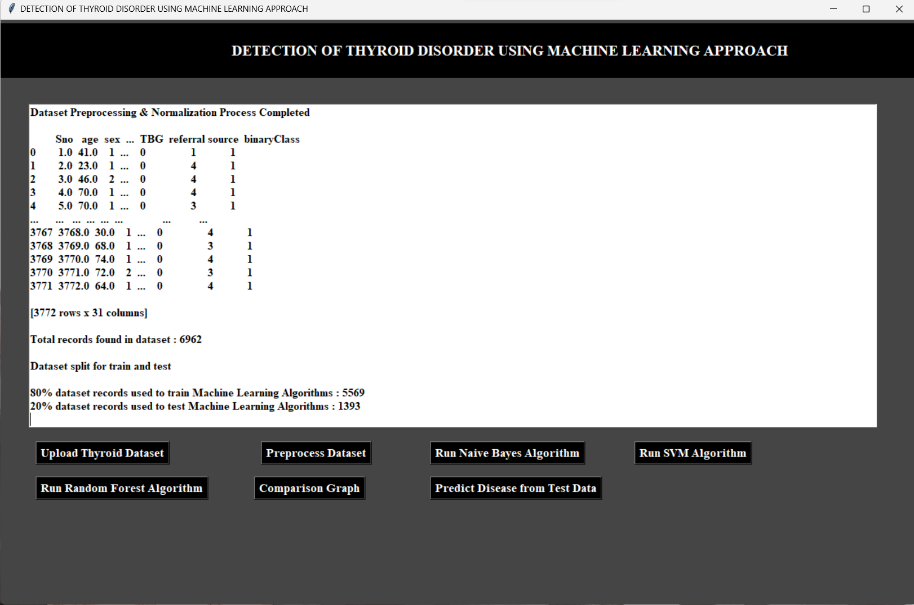

Slide 18
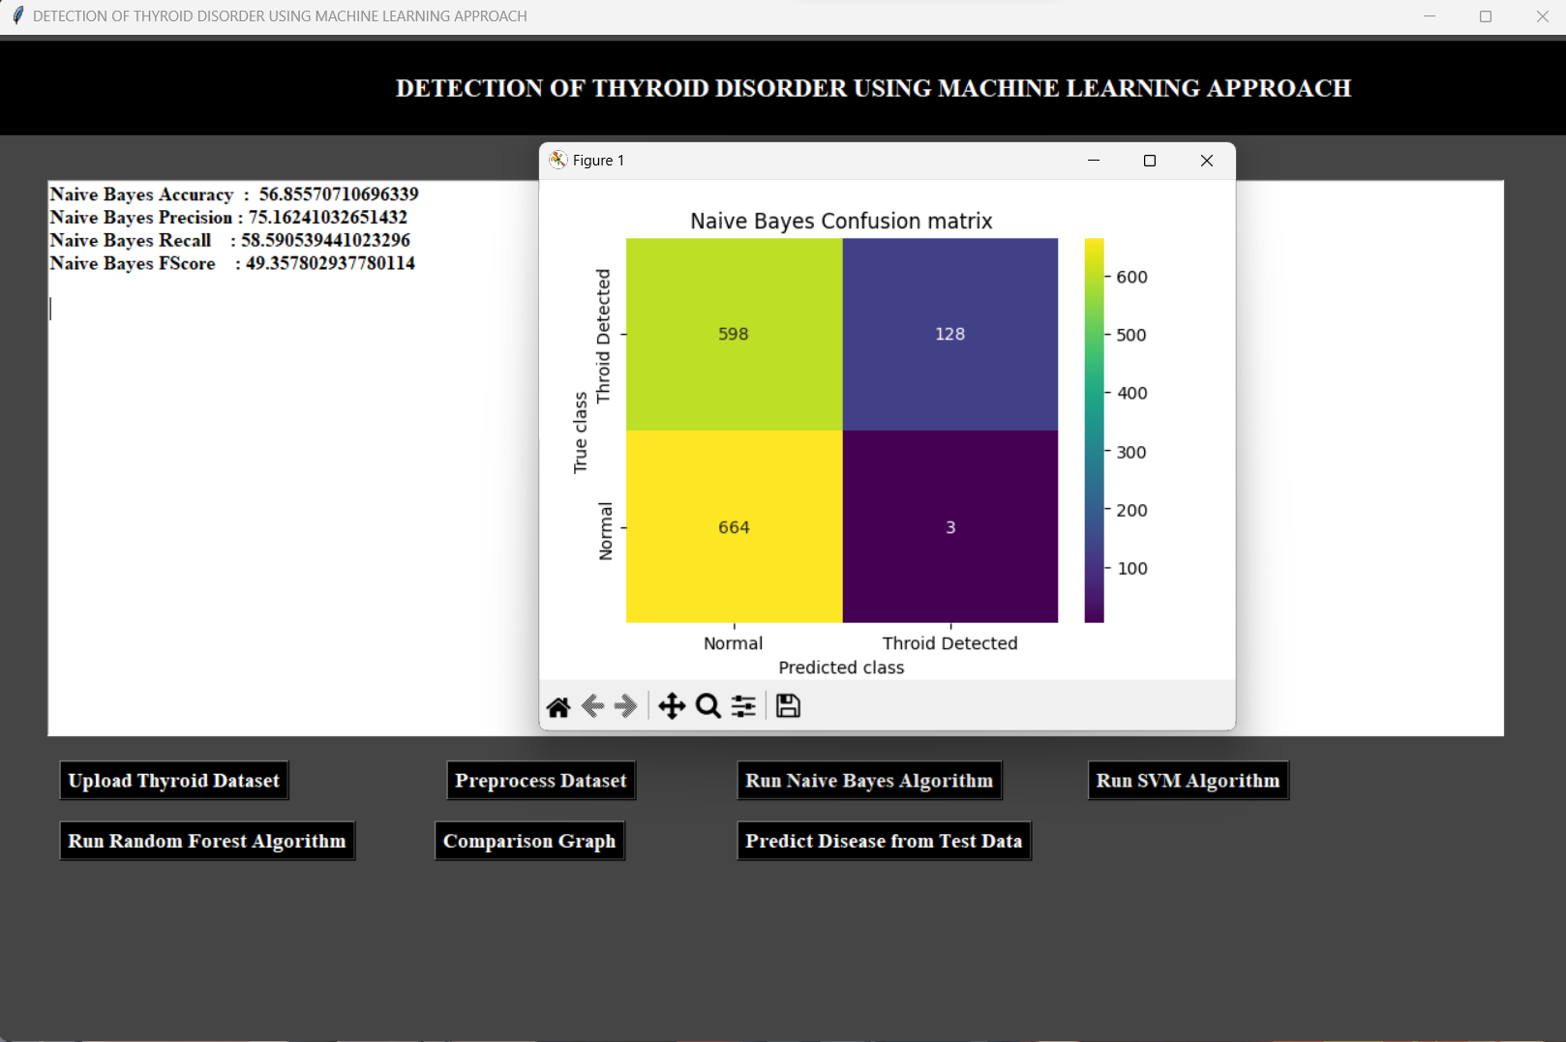

Slide 19
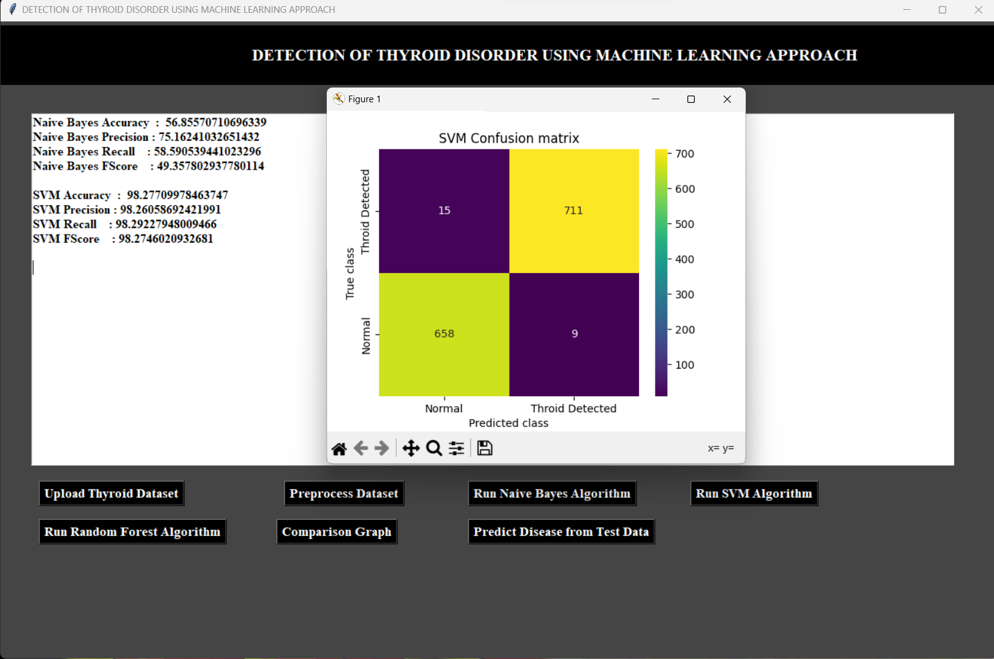

Slide 20
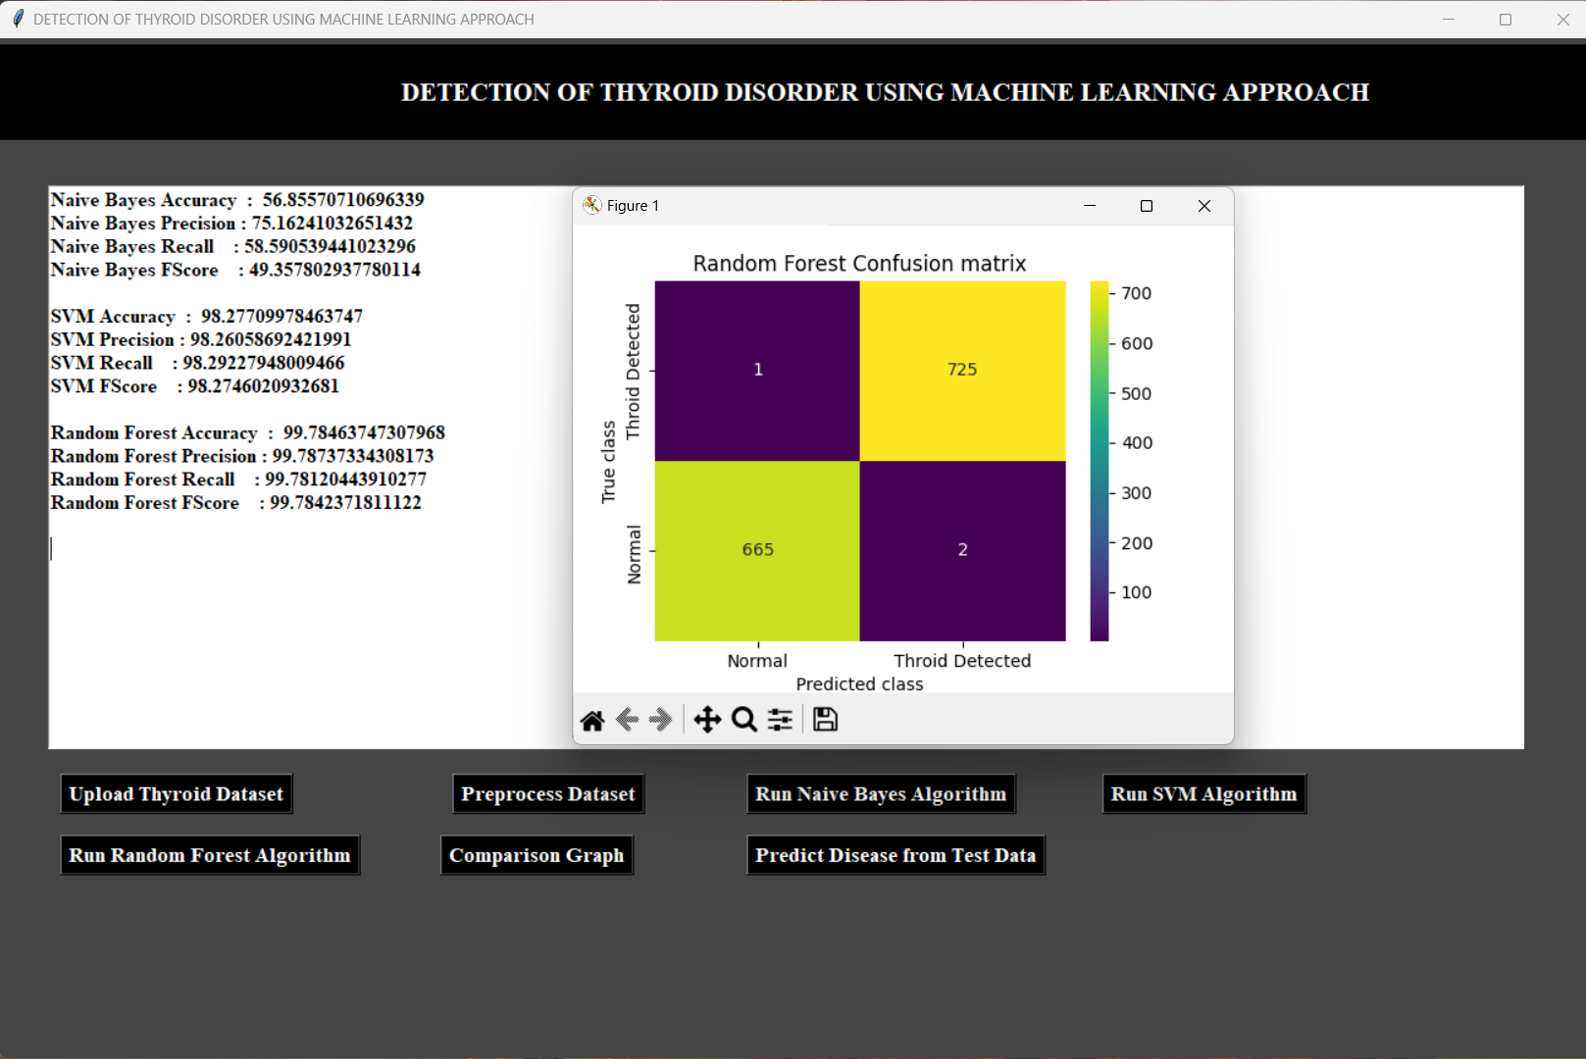

Slide 21
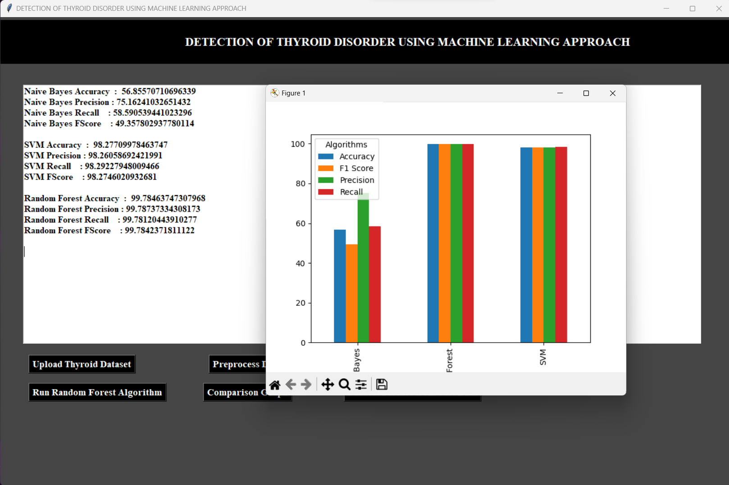

Slide 22
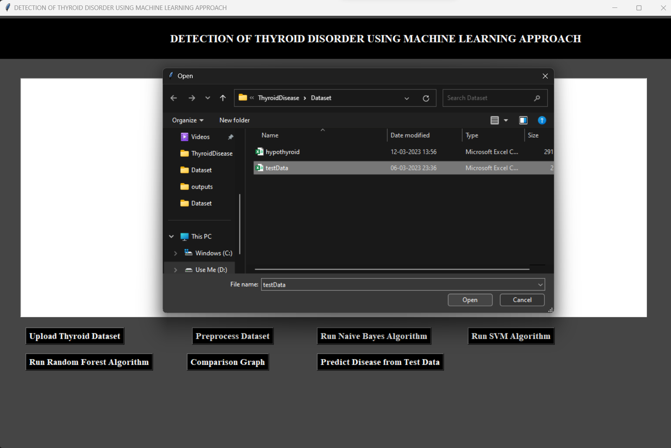

Slide 23
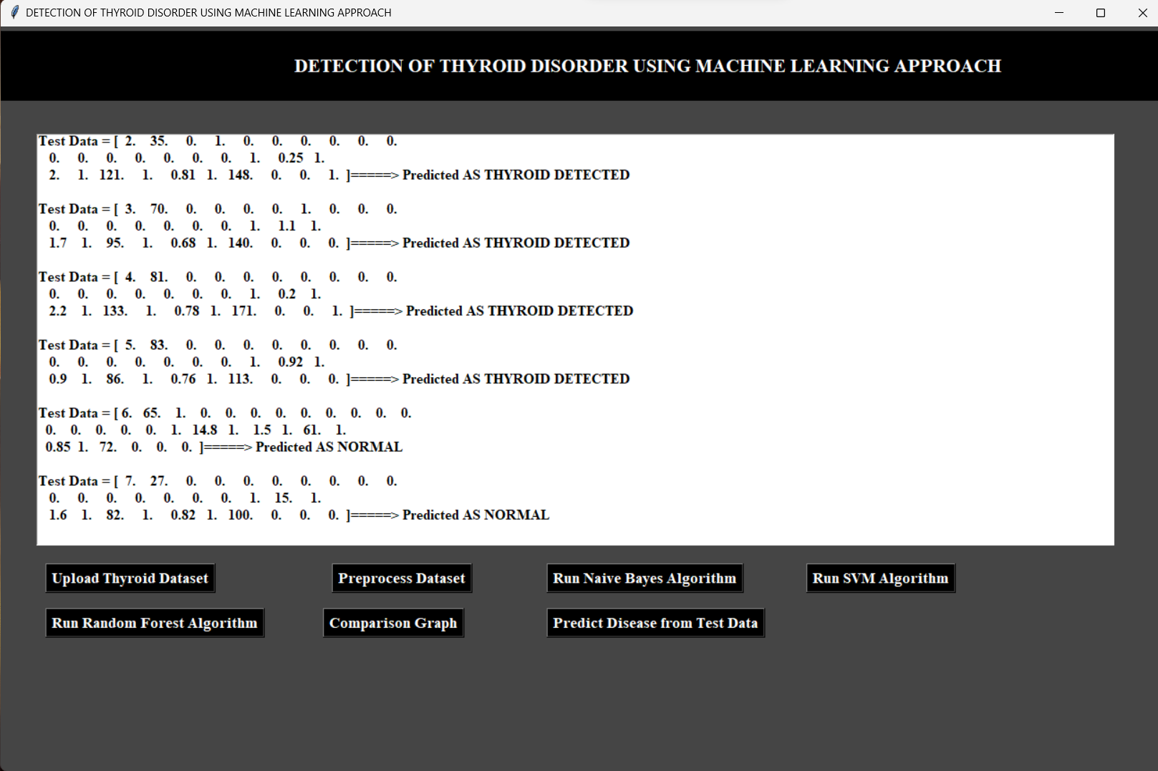

Slide 24
REFERENCES
Lerina Aversanoa, Mario Luca Bernardia, Marta Cimitileb, Martina Iammarinoa, Paolo Emidio Macchiac, Immacolata Cristina Nettorec, Chiara Verdonea."Thyroid Disease Treatment prediction with machine learning approaches". 25th International Conference on Knowledge-Based and Intelligent Information & Engineering Systems, Procedia Computer Science 192 (2021) 1031–1040.
Priyanka Duggal, Shipra Shukla. " Prediction Of Thyroid Disorders Using Advanced Machine Learning Techniques ". 10th International Conference on Cloud Computing, Data Science & Engineering (Confluence).
Marissa Lourdes De Ataide, Amita Dessai. "Thyroid Disease Detection using Soft Computing Techniques". International Research Journal of Engineering and Technology (IRJET).
Hebatullah Mohammad Almahshi, Esraa Abdallah Almasri, Hiam Alquran, Wan Azani Mustafa, Ahmed Alkhayyat. "Hypothyroidism Prediction and Detection Using Machine Learning". 5th International Conference on Engineering Technology and its Applications 2022- (5thIICETA2022) 978-1-6654-7215-9/22/$31.00 ©2022 IEEE.
Dept of CSE., SOE-Dayananda Sagar University

Slide 25
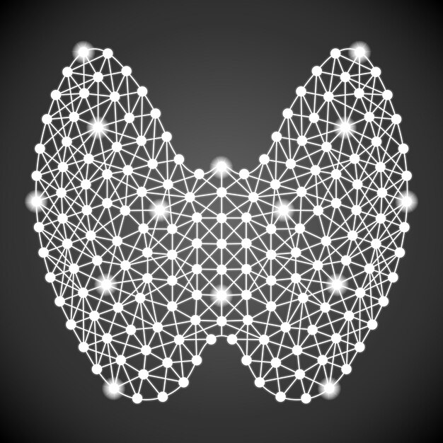
THANKS!
Dept of CSE., SOE-Dayananda Sagar University

